Slide 1
MOTION DETECTION (CAMERA SURVEILLANCE SYSTEM)
Aditya parandekar
Mohit gadi

Slide 2
OVERVIEW
Ultrasonic Sensor
Image Processing and Capturing
Camera module triggered by motion sensor
Dropbox
Image uploaded to Dropbox and user notified
Sense motion through ultrasonic sensor.
Image captured

Slide 3
HARDWARES USED
RASPBERRY PI 3 MODEL B
RASPBERRY PI CAMERA MODULE
ULTRASONIC SENSOR

Slide 4
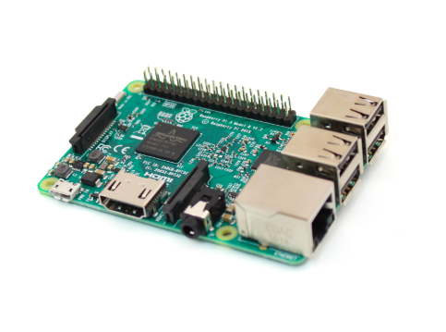
RASPBERRY PI 3 MODEL B
The Raspberry Pi is a small single-board computer.
It was developed to promote basic teaching in Computer Science.
Used to implement Surveillance System in our application.
It can be connected with many other hardware.

Slide 5

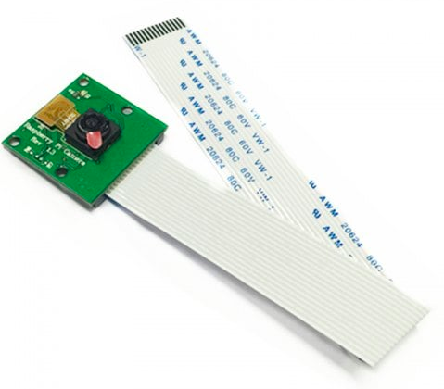
RASPBERRY PI CAMERA MODULE
High quality image sensor custom designed add-on board for Raspberry Pi
Features a fixed focus lens.
We have used a 5 megapixel HD camera module.
Used to click pictures and show live feed.

Slide 6
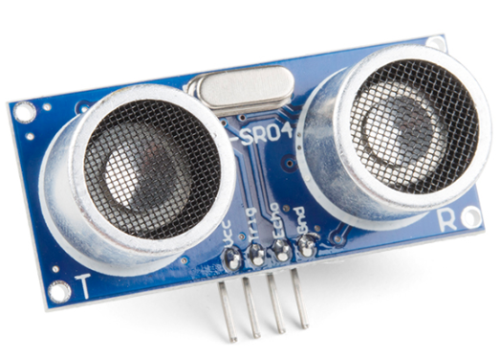
ULTRASONIC SENSOR
Ultrasonic Sensor is used to measure range to an object.
It sends a sound signal and measures the time for the signal to return
Used to trigger camera if object is within 5 meters of the sensor in this project.

Slide 7
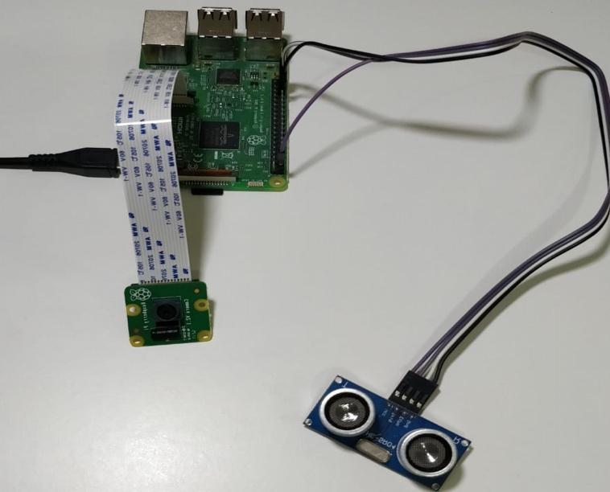
Connected Components. How it looks?!

Slide 8
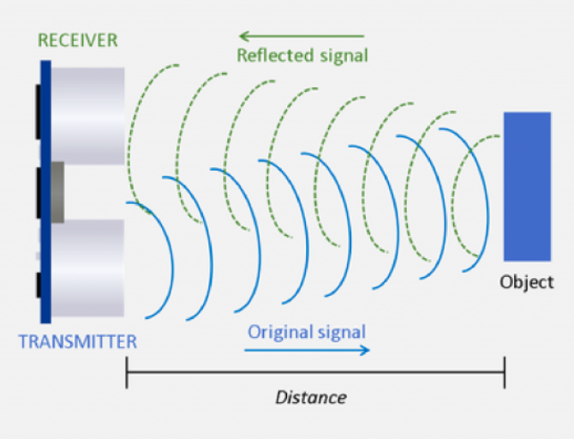
WORKING: STEP 1
The project starts when a motion is detected.
Ultrasonic sensor detects motion if an object comes within 5 meters
After detecting motion, it triggers camera.

Slide 9
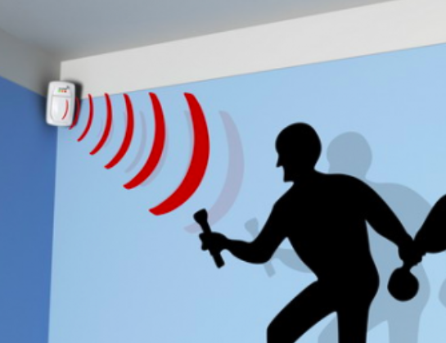
WORKING: STEP 2
After a motion is detected, the image is processed calculating its size and other things.
Image processing algorithm also checks if more than 500 pixels on the frame have changed with respect to last few frames.
If yes then image is captured using camera.

Slide 10

WORKING: STEP 3
After the image is captured, then we have to upload somewhere and notify the user.
We are using dropbox as our database and app for notifying user.
So Images are uploaded to dropbox and users are notified on their dropbox mobile app.

Slide 11
SOFTWARES AND TOOLS USED
Python
Raspbian pi
OpenCV
Dropbox API

Slide 12
DEMO VIDEO

Slide 13
THANK YOU
QUESTIONS??

